Slide 1
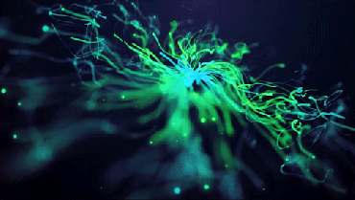
Scrum Stuff
I Love Graphic Design

Slide 2

What does it mean to have an agile mindset?
It means you are capable of showing:
Transparency
Inspection
Adaptation
Because that is what the goal of agile development is.
Everyone knows where everyone is at and can be inspected
Then we adapt to become better

Slide 3



How do companies use Scrum in software development?
They use scrum to manage the creation development and iteration of projects with a standardized management framework.

Slide 4
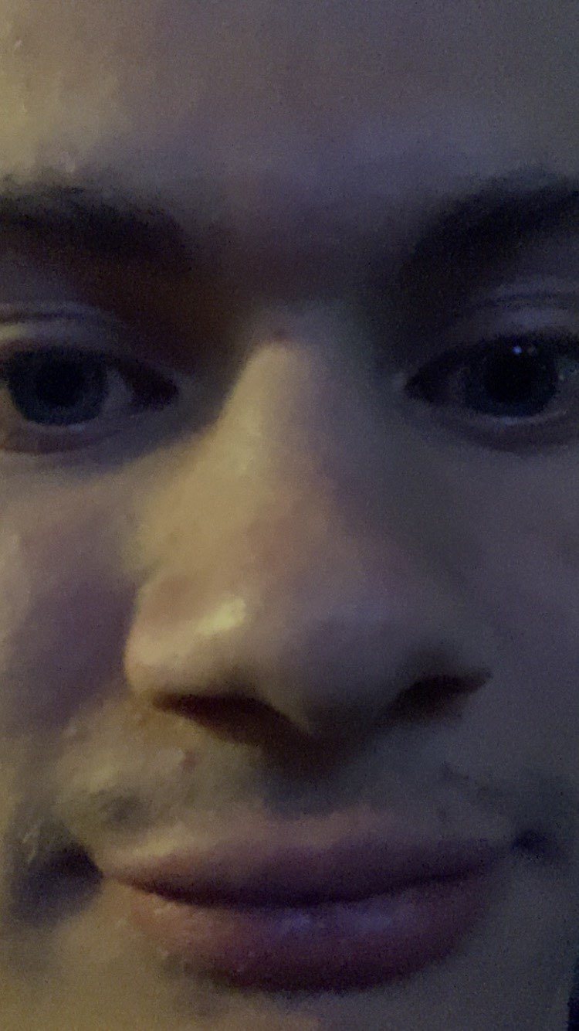


Describe da scrum events
• Scrum (Daily Standup)
○ The Daily Standup is a morning talk where everyone catches each other up on where they are at on their projects
• Sprint
A set period of time for tracking progress, generally 2 weeks
• Sprint Planning
Planning what stuff goes from the project bucketlist to the weeks bucketlist
• Sprint Review
Working with Stakeholders product people and customers to review progress
Sprint Retrospective
The team self reflects on performance and find ways to improve

Slide 5

Scrum Rollz!
• Dev Team
They are the code monkeys who monkey da code and go bananas when it doesn’t work
• Scrum Master
Makes sure all of the scrum stuff is actually being done correctly, very much could be called a scrum manager because they are managing the scrum
Product Owner
They are accountable for maximizing productivity with the team and doing backlog management stuff and defining goals/expectations

Slide 6

Scrum Artifacts
These are pretty much just vocab
• Increment
When something hippity hopps from one phase of the Kanban/Trello/Jira Board to the next
• Product Backlog
The built up list of things we want to work on for the product
Sprint Backlog
The built up list of things we want to work on for this next sprint

Slide 7

Why I think working in scrum could be pretty cool
The organized structure sounds super nice, the transparency is rad

Slide 8


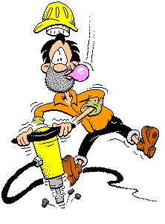





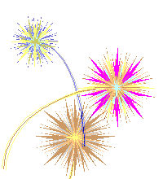
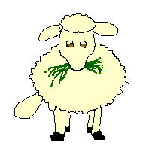



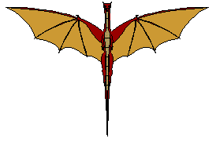


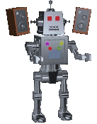
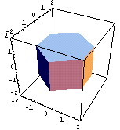



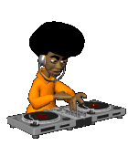











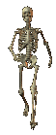
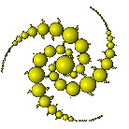




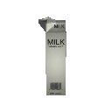
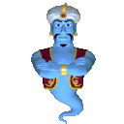




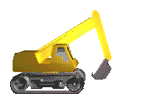


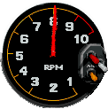


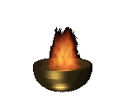
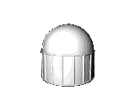


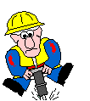









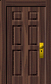





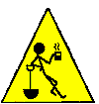


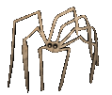






















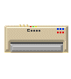





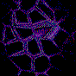










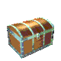
















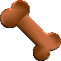


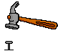





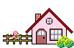
















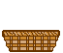

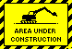








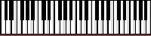
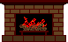






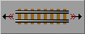


























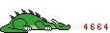








Why I don’t want to work with scrum
The pace sounds super fast and a bit stressful
I would feel bad if I brought our velocity down

